Slide 1

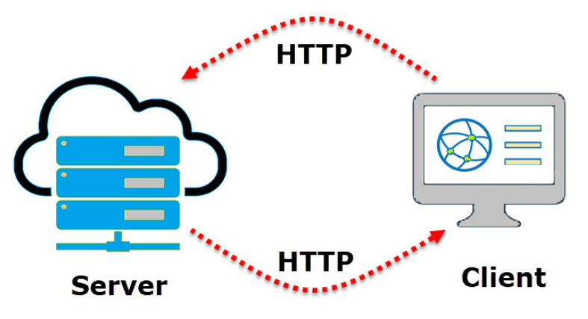
the theory behind creating & configuring WIFI & webservers using the ESP8266
1) Theory on webservers for MCU’s
2) Theory on libraries for MCU’s and those we will be using
3) Theory on the arduino IDE and how to use it
4) Theory and practice on network & wifi configuration
- exploring the ESPWiFi.h library
5) Theory on functions
- creating our first connectTWifi() {…}
6) Theory on WIFI & Webserver configuration and utilization – server / client
- looking into functionalities of theESPAsync.h librarie
- looking into functionalities of theESPAsyncTCP.h librarie
Notes:
6) By combining official documentation, examples, and hands-on experimentation, you'll gain a solid understanding of creating web servers with the ESP8266 using the Arduino framework.

Slide 2



Slide 3
Usually people have an idea that every piece of code is built independtly and from scratch with every program .. And many new to programming wants to built their code from scratch.
But a big part of being a good programmer is be be able to utilize the right libraries that contain the functions needed.
Using the libraries as a foundation from which you can modify your program to your needs and desires.

Slide 4
asynchronous and synchronous webservers - depends on the application
Refers to the way the server handles incoming requests from clients.
microcontrollers like NodeMCU often have limited resources therefore asynchronous servers can be advantageous
NodeMCU, based on the ESP8266 microcontroller, often uses asynchronous programming models for handling Wi-Fi and other async
Libraries like the Arduino ESP8266 core provide functions and callbacks that enable developers to work with asynchronous features efficiently.
Asynchronous servers can be more suitable for handling multiple tasks concurrently, which is often important in IoT (Internet of Things)
Notes:
Synchronous Web Server:
In a synchronous web server, each request is handled one at a time, and the server waits for each operation to complete before moving on to the next one.
If a request involves waiting for external resources (like reading from a sensor or waiting for data from the internet), the server will be blocked until that operation is completed. During this time, it won't be able to handle other requests.
Synchronous servers are simpler to implement but may lead to slower response times, especially if there are delays in processing individual requests.
Asynchronous Web Server:
In an asynchronous web server, the server can handle multiple requests simultaneously without waiting for each one to finish before moving on to the next. It achieves this through mechanisms like callbacks or event-driven programming.
If a request involves waiting for external resources, the server can continue handling other requests while waiting for the resource to become available. This can lead to better performance and responsiveness.
Asynchronous servers can be more complex to implement, as developers need to manage concurrency and ensure that resources are shared safely among different tasks.

Slide 5
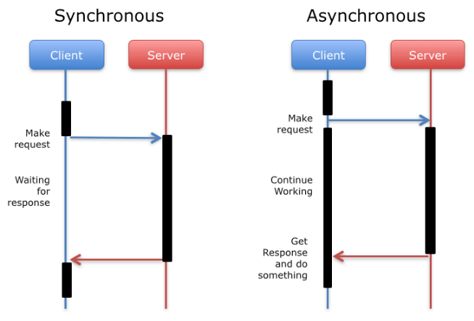

Slide 6
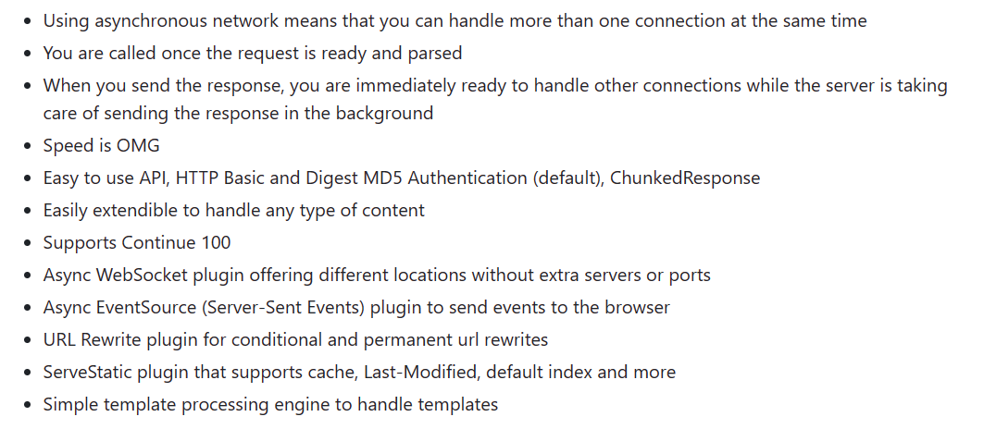
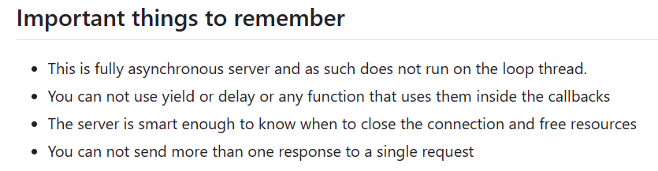
Asynchronous webserver

Slide 7
4 main methods
update entire page as one long string - (slow and ugly method)
XML updates
JSON string updates
websocket updates
And combinations between these…

Slide 8


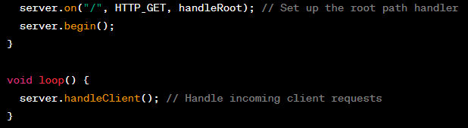

Summarize asynchronous and synchronous webservers & methods of communication
Asynchronous:
Called in the setup allowing the MCU to perform other tasks simultanously.
Synchronous
Called in the loop: blocking until current request is handled.
Notes:
Asynchronous:
the server.handleClient() function is not explicitly called in the loop function.
Instead, the ESPAsyncWebServer library handles asynchronous tasks internally, allowing the microcontroller to perform other non-blocking tasks in the loop.
Requests are handled asynchronously, and you define functions like handleRoot to handle each route.
Synchronous:
the server.handleClient() function is called in the loop function. This function will block until it has handled the current client request.
While waiting for the request to be processed, the microcontroller won't be able to handle other tasks.

Slide 9



Slide 10
Introduction to libraries
collection of pre-written code that simplifies the process of developing code for specific hardware or functionality.
Libraries encapsulate code that performs common tasks, allowing developers to reuse and share code easily
libraries enhance the functionality of the Arduino platform by providing ready-made solutions for various tasks and hardware components
Notes:
Reusable Code:
Libraries contain reusable code snippets, functions, and classes that address specific tasks or interact with certain hardware components. Developers can include these libraries in their Arduino sketches to access the provided functionality without having to write the code from scratch.
Standard Libraries:
Arduino comes with a set of standard libraries that are included by default in the Arduino IDE. These libraries provide essential functionalities for tasks such as input/output, communication, and timekeeping. Examples include Wire for I2C communication and Serial for serial communication.
User-Contributed Libraries:
The Arduino community contributes a vast number of libraries that extend the capabilities of the platform. These user-contributed libraries cover a wide range of topics, from interfacing with sensors and actuators to communication protocols and advanced algorithms.
Library Manager:
The Arduino IDE includes a Library Manager, which is a tool that simplifies the process of installing, updating, and managing libraries. Users can access the Library Manager through the Arduino IDE menu ("Sketch" > "Include Library" > "Manage Libraries...").
Installing Libraries:
To use a library in an Arduino sketch, you typically need to install it first. This is done through the Library Manager, where you can search for libraries, install them, and manage versions.
Header Files and Source Code:
Libraries usually consist of header files (.h) that contain function prototypes and declarations, and source code files (.cpp) that contain the implementation of the functions. When you include a library in your sketch, you're essentially including its header files.
Examples:
Many libraries come with example sketches that demonstrate how to use the library's features. These examples serve as valuable learning resources for understanding how to implement specific functionalities.
Community Contributions:
The Arduino community actively contributes to the development of libraries, making it a collaborative effort. Developers often share their libraries with the community, fostering an environment of open-source hardware and software.

Slide 11
Libraries we need
The ESPAsyncWebServer library
GitHub - me-no-dev/ESPAsyncWebServer: Async Web Server for ESP8266 and ESP32
Rename the library folder to ESPAsyncWebServer
The ESPAsyncTCP library
GitHub - me-no-dev/ESPAsyncTCP: Async TCP Library for ESP8266
The ESP8266WiFi.h library

Slide 12

ESP8266WiFi.h
ESP8266WiFi.h is part of the arduino core for ESP8266 modules.
It provides functions and methods to configure and manage Wi-Fi connections on ESP8266-based devices when using the Arduino programming environment.
simplifies the process of configuring and managing Wi-Fi connections on the ESP8266.
-more info on link below
ESP8266WiFi library — ESP8266 Arduino Core 3.1.2-21-ga348833 documentation (arduino-esp8266.readthedocs.io)
Notes:
WiFi Connection Setup:
Functions:
WiFi.begin(ssid, password): Initiates a connection to a Wi-Fi network with the specified SSID (network name) and password.
WiFi.disconnect(): Disconnects from the currently connected Wi-Fi network.
WiFi.status(): Returns the current connection status (e.g., connected, disconnected).
Event Handling:
Functions:
WiFi.onEvent(handlerFunction): Sets a callback function to handle Wi-Fi events, such as connecting, disconnecting, or obtaining an IP address.
WiFi.waitForConnectResult(): Blocks execution until a connection attempt is successful or unsuccessful.
Access Point Mode:
Functions:
WiFi.softAP(ssid, password): Configures the ESP8266 to act as an access point (AP) with the specified SSID and password.
WiFi.softAPdisconnect(): Disconnects the ESP8266 from the access point.
Station Mode (Client Mode):
Functions:
WiFi.mode(WIFI_STA): Sets the ESP8266 to station mode (client mode).
WiFi.scanNetworks(): Scans for available Wi-Fi networks and returns a list of discovered networks.
IP Address Configuration:
Functions:
WiFi.localIP(): Returns the local IP address assigned to the ESP8266 on the connected network.
WiFi.macAddress(): Returns the MAC (Media Access Control) address of the ESP8266.
Advanced Configuration:
Functions:
WiFi.hostname(hostname): Sets the hostname to be used when requesting an IP address via DHCP.
WiFi.config(ip, gateway, subnet): Manually sets the IP address, gateway, and subnet mask for the ESP8266.
Custom DNS Configuration:
Functions:
WiFi.setDNS(dns_server1, dns_server2): Sets custom DNS (Domain Name System) servers for the ESP8266.
Secure Connections (SSL/TLS):
Functions:
WiFiClientSecure: Extends the WiFiClient class to support SSL/TLS connections.
Client and Server Modes:
Functions:
WiFiServer: Creates a server that listens for incoming client connections.
WiFiClient: Represents a client that can connect to a remote server.

Slide 13
ESPAsyncWebServer.h

Slide 14
ESPAsyncTCP.h

Slide 15
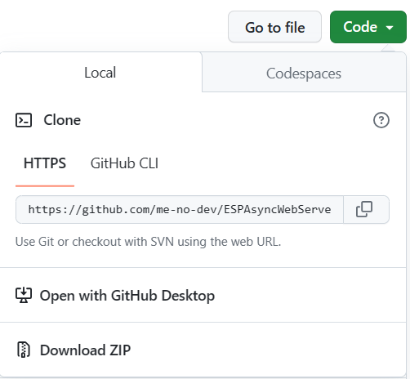

In code ‘dropdown’ click download ZIP
Place in your library folder

Slide 16



Slide 17
Introduction to using the arduino IDE
1) includes
2) instatiations
3) global variable declarations
4) the setup()
5) the loop()
Notes:
We include libraries we need
We instantiate those objects from the library
We setup variables we need trough out the program, which can be accessed through out the program
4) We initialize surden things, the setup() runs once when the MCU is started
5) We use the loop for things that need to run continously

Slide 18


1 & 2 – #Include libraries || header files & instantiate objects
Used to include external libraries or header files
A way to bring in additional functionality or definitions that are not part of the standard Arduino core
instantiation of objects involves creating instances of classes
a class is a blueprint or a template that defines the characteristics and behavior of an object, and an object is an instance of that class.

Slide 19





3 – declaring global variables
variables for our local wifi network.
Variable for updating the state on our webpage
Variables for our pin connections (constant)
Variables for keeping track of the states on our inputs/outpus (not constant)
Variables for time functionality.
Notes:
Const char is a datatype which can hold caracters (both ‘single’ and as “strings” – notice the ‘’ for single caracters and “” for strings)
- so for example the variable ssid wil be what ever you assign it through out the program.
Const int means that the number we set to the variable cannot be changed later in the program.
The ledState variable holds the LED output state. As default, when the MCU starts, it is set to LOW
The button variables will be used in order to keep track of wether the button is pressed or not
The time variables will be used in order to make time functions using millis() – we cannot use delay when working with webservers

Slide 20
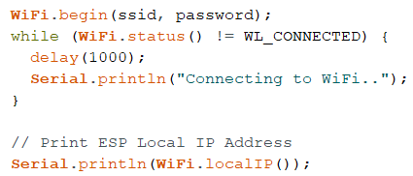

4 - The void setup() {…..}
.
called once when the MCU starts running the program
typically used for initializations and setup tasks
This may include setting up communication, initializing variables, configuring pins, and other setup tasks
void indicates that the function doesn't return any value
Notes:
Also it is ok in some degree to use delay() function here.. Where it is more critical to limit the use in the loop().. More on that..
Server.on(

Slide 21
5 - The void loop() {…..}
contains the main logic and code of your program
runs repeatedly after the setup function
Similar to the setup function, void indicates that the function doesn't return any value.
Notes:
Here it is good practice to use the millis() function instead of delay()

Slide 22
Summarize the arduino IDE
The Arduino board starts, and the setup function is called once for initialization.
After the setup function completes, the Arduino enters an infinite loop, repeatedly calling the loop function.
The code inside the loop function runs, implementing the main logic of your program.
Once the loop function completes, it starts again from the beginning.
The setup and loop functions provide a simple and structured framework for writing Arduino sketches. The setup function is for one-time setup tasks, and the loop function contains the main program logic that runs continuously.

Slide 23



Slide 24
Networking and WIFI configuration
Access point mode (AP)
Stations mode
Soft AP mode
Ethernet
Lora (long range)
Bluetooth
Cellular
We will be focusing on Station Mode where we connect to our own local network.
IP configuration:
DHCP: Dynamic Host Configuration Protocol.
Configuration of Static IP
Notes:
The choice of networking option depends on the specific requirements of your project, such as range, power consumption, and the need for internet connectivity.
Additionally, consider the capabilities of the microcontroller and the available libraries or frameworks that support the desired networking option.
DHCP:
Request by Device:
When a device (such as a computer, smartphone, or Raspberry Pi) joins a network and is configured to use DHCP, it sends a DHCP request to the network.
DHCP Server Response:
A DHCP server on the network responds to the request by providing the requesting device with an IP address, subnet mask, default gateway, and other configuration information.
Lease Duration:
The DHCP server typically assigns IP addresses on a lease basis. The lease duration specifies how long the device is allowed to use the assigned IP address. Before the lease expires, the device may request a lease renewal.
Dynamic Assignment:
DHCP allows for dynamic assignment of IP addresses, meaning that devices can receive different IP addresses each time they connect to the network. This dynamic assignment is in contrast to static IP addressing, where devices are manually configured with fixed IP addresses.
Centralized Management:
DHCP provides a centralized and automated way to manage IP addresses, reducing the administrative overhead associated with IP address configuration.

Slide 25
Introduction to ESP8266WiFi.h

Slide 26

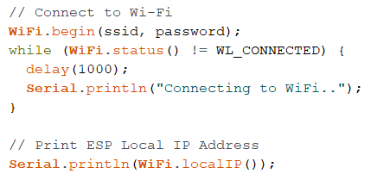
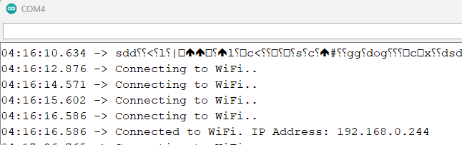
Connect to to wifi (IP address via DHCP)
Notes:
DHCP: Dynamic Host Configuration Protocol.
Request by Device:
When a device (such as a computer, smartphone, or Raspberry Pi) joins a network and is configured to use DHCP, it sends a DHCP request to the network.
DHCP Server Response:
A DHCP server on the network responds to the request by providing the requesting device with an IP address, subnet mask, default gateway, and other configuration information.
Lease Duration:
The DHCP server typically assigns IP addresses on a lease basis. The lease duration specifies how long the device is allowed to use the assigned IP address. Before the lease expires, the device may request a lease renewal.
Dynamic Assignment:
DHCP allows for dynamic assignment of IP addresses, meaning that devices can receive different IP addresses each time they connect to the network. This dynamic assignment is in contrast to static IP addressing, where devices are manually configured with fixed IP addresses.
Centralized Management:
DHCP provides a centralized and automated way to manage IP addresses, reducing the administrative overhead associated with IP address configuration.

Slide 27

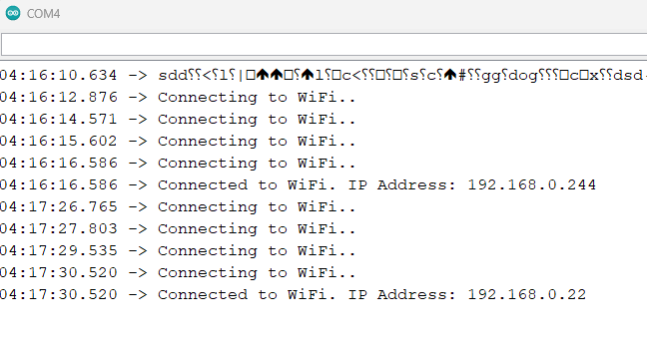
Connect to WIFI (Static IP)

Slide 28



Slide 29
Going deeper with functions
1)
2) Create basic function: connectToWiFi () {…}

Slide 30
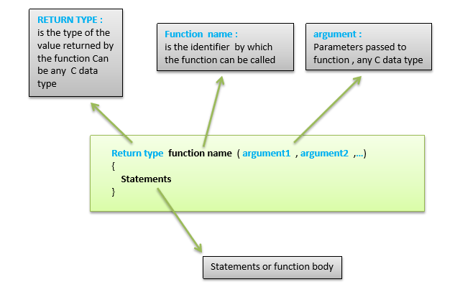
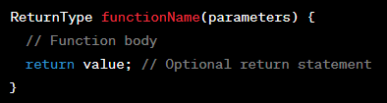
6 - functions and return types
the return type of a function indicates the type of data that the function will return to the calling code after it has executed.
When creating a webpage in arduino IDE we will be using functions that include other lauguages such as JavaScript and/or XML and/or JSON. More on this on the next slide.
Notes:
ReturnType: This is where you specify the type of data that the function will return. It can be a fundamental data type (like int, float, char, etc.) or a more complex type, including user-defined types (e.g., structures or classes).
functionName: The name of the function.
parameters: If the function takes input parameters, they are listed inside the parentheses.
return value;: This statement is optional. If present, it specifies the value that the function will return. If the return type is void, this statement is omitted.
Arduino programming environment, functions can either return data or not
void: This is the return type of the setup function. In C++, void is used to indicate that the function does not return any value.
No Return Statement: The setup function does not contain a return statement because it doesn't need to return any specific value.

Slide 31
1 – create a function: ConnectToWifi() {…}
Lets take what we learned from the previuos lesson about setting up wifi and make a function we can call once in the setup() for modularity.
We want to encapsulate this piece
Of code in a function an call it once
In the setup()
Notes:
Exercises:
Explore the ESPWiFi.h libraries functionality

Slide 32
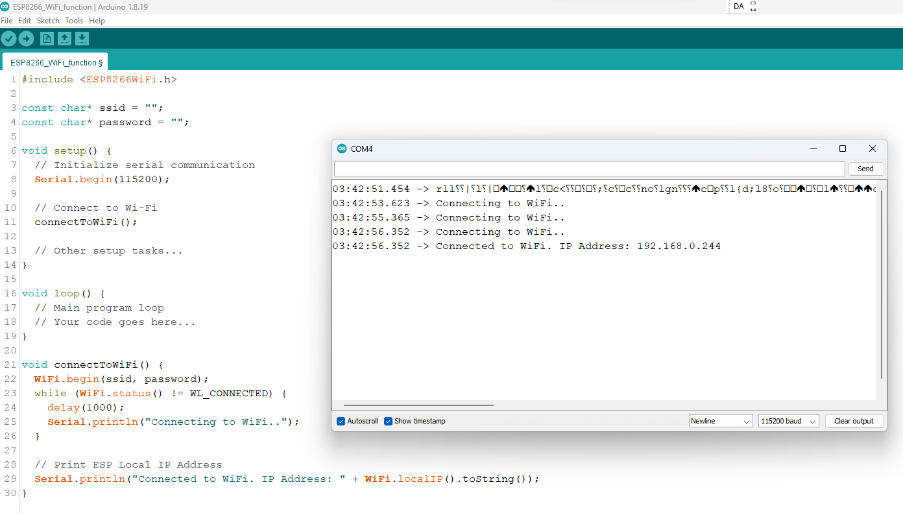
Notes:
Notice how we only use the setup() function because we are just initalizing a connection and running any continous program.

Slide 33


Notes:
Official Documentation:
Start by exploring the official documentation for the ESP8266 Arduino Core. This documentation provides detailed information about the capabilities of the ESP8266 and how to use it with the Arduino IDE.
ESP8266 Arduino Core Documentation
Example Sketches:
The Arduino IDE includes example sketches that demonstrate various functionalities, including web server development. Look for examples related to the ESP8266WebServer library.
Open the Arduino IDE, navigate to "File" > "Examples" > "ESP8266WebServer" to find relevant examples.
Online Tutorials:
Search for online tutorials and guides that walk you through the process of creating a web server with an ESP8266. Many community members and websites provide step-by-step instructions and explanations.
Look for tutorials on platforms like GitHub, Instructables, or personal blogs.

Slide 34
Communicating between client and server - ESP8266AsyncWebServer.h & ESPAsyncTCP.h
TCP & HTTP methods
URL routing
Handling requests
Request parameters
Sending responses
Static files
Handling websockets
HTTP Authentication
Security
Notes:
Basic Web Server:
Begin with a basic example that sets up a web server and responds to a simple HTTP request.
Adding Routes:
Extend your server to handle different routes (URLs). Learn how to use the server.on() function to define functions that respond to specific routes.
Handling Parameters:
Explore how to handle parameters in the URL or request body. Learn how to extract data sent by the client.
Serving Static Files:
Understand how to serve static files such as HTML, CSS, and JavaScript from your ESP8266. This is crucial for building web applications.
Adding Dynamic Content:
Integrate dynamic content by generating HTML responses dynamically based on the server's state or sensor readings.
Implementing WebSockets:
Explore how to use WebSockets for real-time communication between the server and connected clients.
Authentication:
Implement basic authentication to secure specific routes or resources on your server.
Handling Form Submissions:
Learn how to handle form submissions from HTML forms on your web pages.
Error Handling:
Implement error handling to manage unexpected situations gracefully.
Community Support:
If you encounter challenges, don't hesitate to seek support from the Arduino and ESP8266 communities. Forums, such as the Arduino Forum and ESP8266 Community Forum, are excellent resources for getting help.

Slide 35
(1) Transmission control protocol (TCP)
The ESP8266AsyncWebServer.h relies on the ESPAsyncTCP.h library because of its underlying asynchronous TCP communication capabilities, where the microcontroller needs to handle multiple tasks simultaneously without blocking the execution of other tasks.
The ESP8266AsyncWebServer.h relies on the ESPAsyncTCP.h in order to manage the TCP connections that are essential for handling HTTP requests and responses in a non-blocking manner
Notes:
TCP together with IP (Internet Protocol), it forms the foundation of the Internet and many other networks. TCP provides reliable, connection-oriented communication between devices on a network.
Three-Way Handshake:
To establish a connection, TCP uses a three-way handshake:
SYN (Synchronize): The initiating device sends a SYN packet to the receiving device to request a connection.
SYN-ACK (Synchronize-Acknowledge): The receiving device responds with a SYN-ACK packet, indicating acknowledgment and agreement to establish the connection.
ACK (Acknowledge): The initiating device sends an ACK packet, confirming the establishment of the connection.
Full-Duplex Communication:
TCP enables full-duplex communication, meaning that data can be sent and received simultaneously by both devices in a communication session.
Example in the Context of Web Servers:
When you access a website through your web browser, it typically uses HTTP over TCP. A TCP connection is established between your device and the web server to ensure reliable and ordered communication of the HTTP data.
In summary, TCP is a fundamental protocol that provides reliable, connection-oriented communication in networks. It ensures the accurate and orderly exchange of data between devices, making it suitable for a wide range of applications on the Internet.
.

Slide 36
(2) URL routing (the request body and the URL ) - Hypertext transfer protocol (HTTP) over TCP
HTTP Methods:
Request Body: It allows clients to submit information such as form data, JSON, or binary data.
HTTP_GET: method is used by clients (such as web browsers) to request data from a specified resource.
HTTP_POST: method is used by clients to submit data to be processed to a specified resource. It is often used when dealing with forms, file uploads, or other scenarios where data needs to be sent to the server
See examples of usage with the ESPAsyncWebServer.h library in the learning by doing PP.
Notes:
1: URL routing: Define routes on your web server to map URLs to specific functions or handlers.
For example, you might have a route for the root ("/") and additional routes for different pages or functionalities.
In this example, the handleRoot function is called when the root ("/") is accessed, and the handleAbout function is called when the "/about" route is accessed.
2:

Slide 37
(2) URL routing

Slide 38
Webserver functions

Slide 39
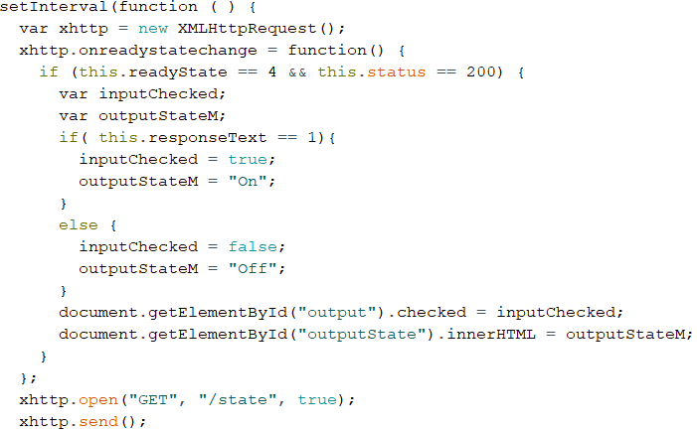
setInterval() {…}
Using JavaScript to make periodic AJAX (Asynchronous JavaScript and XML) requests to a server.
Notes:
The setInterval function is used to execute the provided function at regular intervals. In this case, it makes an AJAX request every 1000 milliseconds (1 second).
Inside the function passed to setInterval, a new XMLHttpRequest object (xhttp) is created. This object is used to make HTTP requests from the browser.
The onreadystatechange event is set to a function that will be called whenever the readyState of the XMLHttpRequest object changes.
Inside the onreadystatechange function, it checks if the request is complete (readyState == 4) and if the response status is successful (status == 200).
If the conditions are met, it processes the response (responseText) from the server. If the response is '1', it sets inputChecked to true and outputStateM to "On". Otherwise, it sets inputChecked to false and outputStateM to "Off".
Finally, it updates HTML elements with the IDs "output" and "outputState" with the values of inputChecked and outputStateM, respectively.
This code is often used in web development when you want to update parts of a web page dynamically without reloading the entire page. It's common in scenarios where the server sends updates to the client periodically, and the client updates its UI accordingly.

